Slide 1

Directory Size Calculator Application
By: Ahoura Minaeian

Slide 2
Table of Contents
OBJECTIVE
APPROACH & DESIGN
KEY FILES & FOLDERS
PROCESS TO RUN, TEST, & VERIFY
TEST/SEED DATA & VERIFICATION
FUTURE ADDITIONS & IMPROVEMENTS

Slide 3
Objective
To create an application that simulates a file system with a hierarchical structure of directories (folders) containing files.
For each file to have a size attribute.
Data to be kept in memory or in file
Application to support the following basic commands:
  cd
  ls
  Size

Slide 4
Objective Cont.
cd – Change Directory
  Navigate through directories (current to new)
ls – List Directory Content
  List and display names, file sizes, and folders within a directory
Size - Calculate the total size of the current directory, covering all the files in the directory and its subdirectories
  Recursion to be used to calculate the size

Slide 5
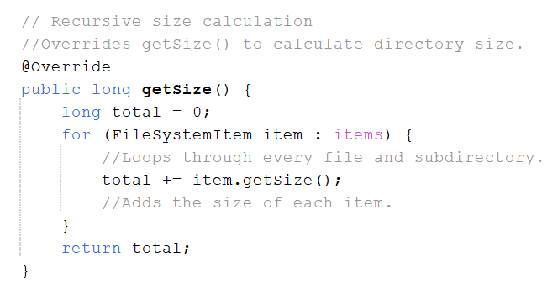
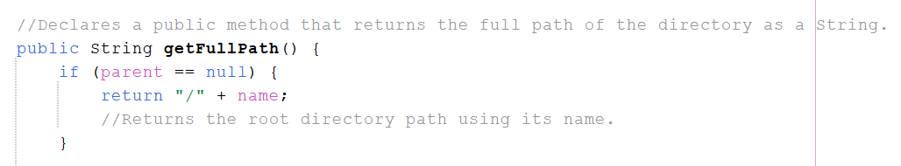
Approach & Design
Coded in Java (Apache NetBeans (JDK25))
Used OOP principles
Implemented an abstract base class (FileSystemItem) to represent shared behavior
Used inheritance and polymorphism to distinguish between files and directories
Applied recursion to compute directory sizes efficiently

Slide 6
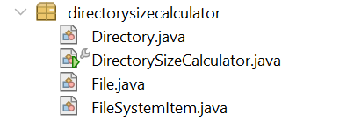
Key Files & Folders
DirectorySizeCalculator.java – Main driver program
Directory.java – Represents directories that contain files or subdirectories
File.java – Represents files with fixed sizes
FileSystemItem.java – Abstract base class for file system objects

Slide 7
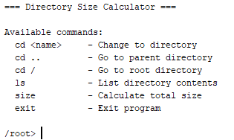
Process to Run, Test, & Verify
Compile all Java files
Run DirectorySizeCalculator
The program initializes sample data and outputs the total directory size

Slide 8
Test/Seed Data & Verification
root/ (29184 bytes total)
├── readme.txt (1024 bytes)
├── documents/ (9728 bytes total)
│ ├── report.pdf (2048 bytes)
│ ├── notes.txt (512 bytes)
│ └── projects/ (7168 bytes total)
│ ├── project1.java (3072 bytes)
│ └── project2.java (4096 bytes)
└── images/ (18432 bytes total)
├── photo1.jpg (10240 bytes)
└── photo2.png (8192 bytes)
Test data is seeded directly in the main method with sample files and nested directories.
The output verifies correct recursive size calculation across nested directory structures.

Slide 9
Future Additions & Improvements
Upscale the size of the total directory
  More files/subfiles/lists
Add more commands
  Easier traversal of the directories
Optimization
  Make the code cleaner and easier to read and use faster methods

Slide 10

THANK YOU!
If you have any questions or want me to walk through any part of the project, please DO hesitate to ask (JK ask away).
Thank you & have a great rest of your day!

